Slide 1
SQL Server Reporting Services
Lecturer: Ngo Huy Bien
Software Engineering Department
Faculty of Information Technology
VNUHCM - University of Science
Ho Chi Minh City, Vietnam
nhbien@fit.hcmus.edu.vn

Slide 2

Objectives
To use Report Designer to create paginated reports.
To deploy reports to reporting services web portal.

Slide 3

Contents
Microsoft reporting services
Report server project
Reports deployment

Slide 4

References
Brian Larson (2017). Microsoft SQL Server 2016 Reporting Services. McGraw-Hill Education.

Slide 5
Report Types [1]
Paginated reports are those reports that require exact placement and formatting of all elements on the report.
Mobile reports are built to be displayed on smartphones and tablets.
Interactive reports are created to allow the user to explore the data. The interactive reporting environment focuses on allowing the user to continuously interact with the data by slicing, filtering, and drilling down.
Analytical reports are created within what has been the leading tool for data analysis for many years—Microsoft Excel. Pivot tables and pivot charts provide robust reporting right within an Excel spreadsheet.

Slide 6
Custom Web Applications
You could use one of a number of tools for creating data-driven HTML pages. This would include Microsoft’s ASP.NET, any of a number of Java environments, Hypertext Preprocessor (PHP).
They all take time and a certain level of programming knowledge.

Slide 7
3rd Reporting Environments
The problem with third-party reporting environments such as Cognos or Tableau is the cost.

Slide 8
Why Microsoft Reporting Services?
No programming required
Reporting Services provides a simple drag-and-drop approach to creating reports from database information.
You can use a number of different tools to author reports. The Report Builder and the Report Designer in Visual Studio/SQL Server Data Tools let you truly unlock the power of Reporting Services to convey complex information.
The price is right

Slide 9
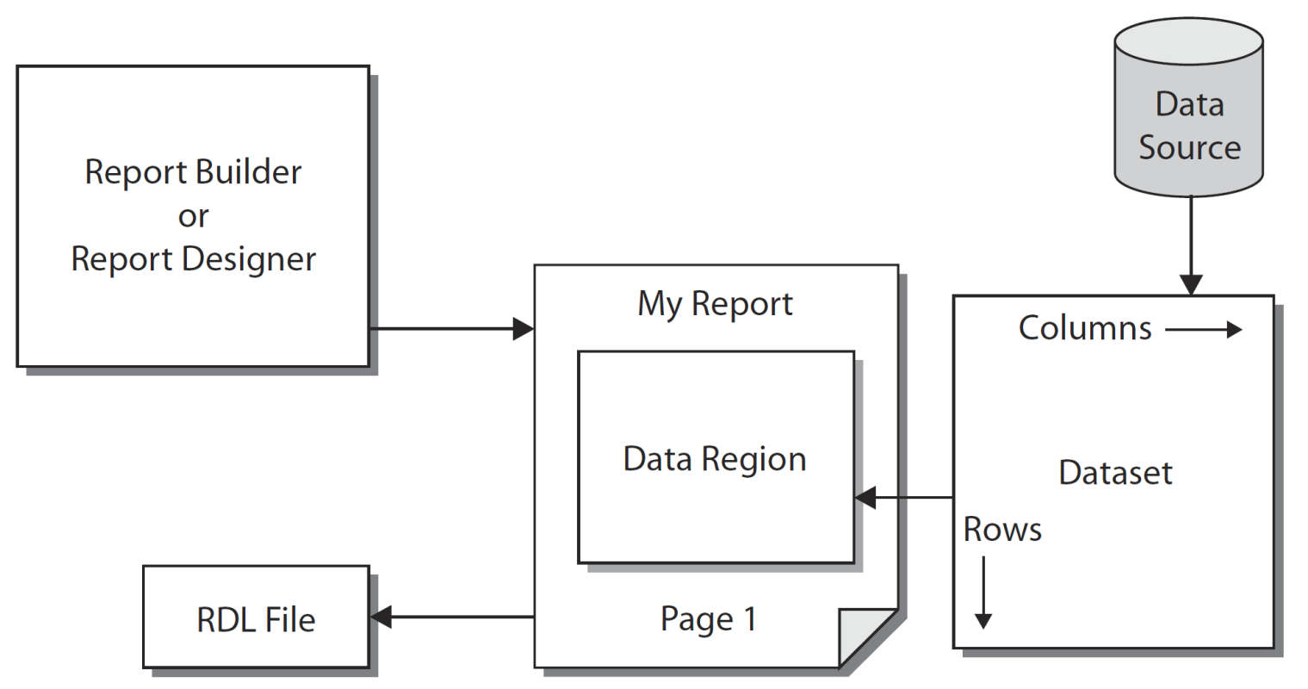
Paginated Report Structure
The information in the data definition and the report layout is stored using the Report Definition Language (RDL).
RDL is an Extensible Markup Language (XML) standard designed by Microsoft specifically for storing report definitions.

Slide 10
Data Source and Dataset
The data source is the database server or data file that provides the information for your report.
The data source itself is not included in the report. What is included is the set of instructions the report needs to gain access to that data source.
When the report is executing, it uses the data source instructions contained in the report to gain access to the data source.
It then extracts information from the data source into a new format that can be used by the report. This new format is called a dataset.

Slide 11
The Query Designer
The content of the dataset is defined using a tool called the Query Designer.
The Query Designer helps you build a database query.
The database query may be in
Transact-Structured Query Language (T-SQL) for querying relational data,
Multidimensional Expression language (MDX) for querying SQL Server Analysis Services data models, or
Data Mining Expression language (DMX) for querying data-mining data.

Slide 12
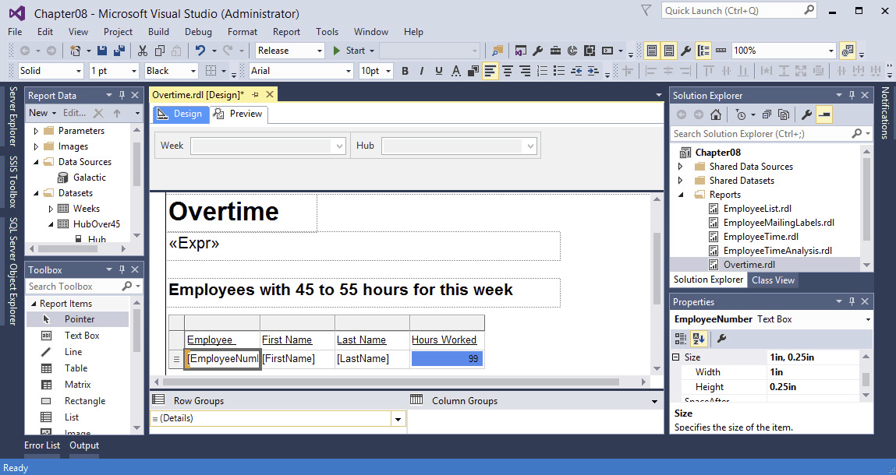
Report Designer
This is the tool you use for creating and editing reports.

Slide 13
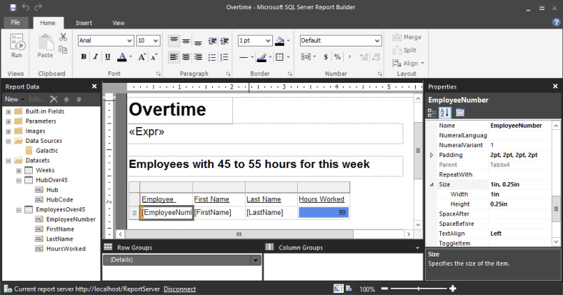
Report Builder
The Report Builder uses the ribbon-style user interface found in Microsoft Office 2010 and later. This is the main difference between the Report Designer and the Report Builder.
The Report Builder does not have a Toolbox.

Slide 14
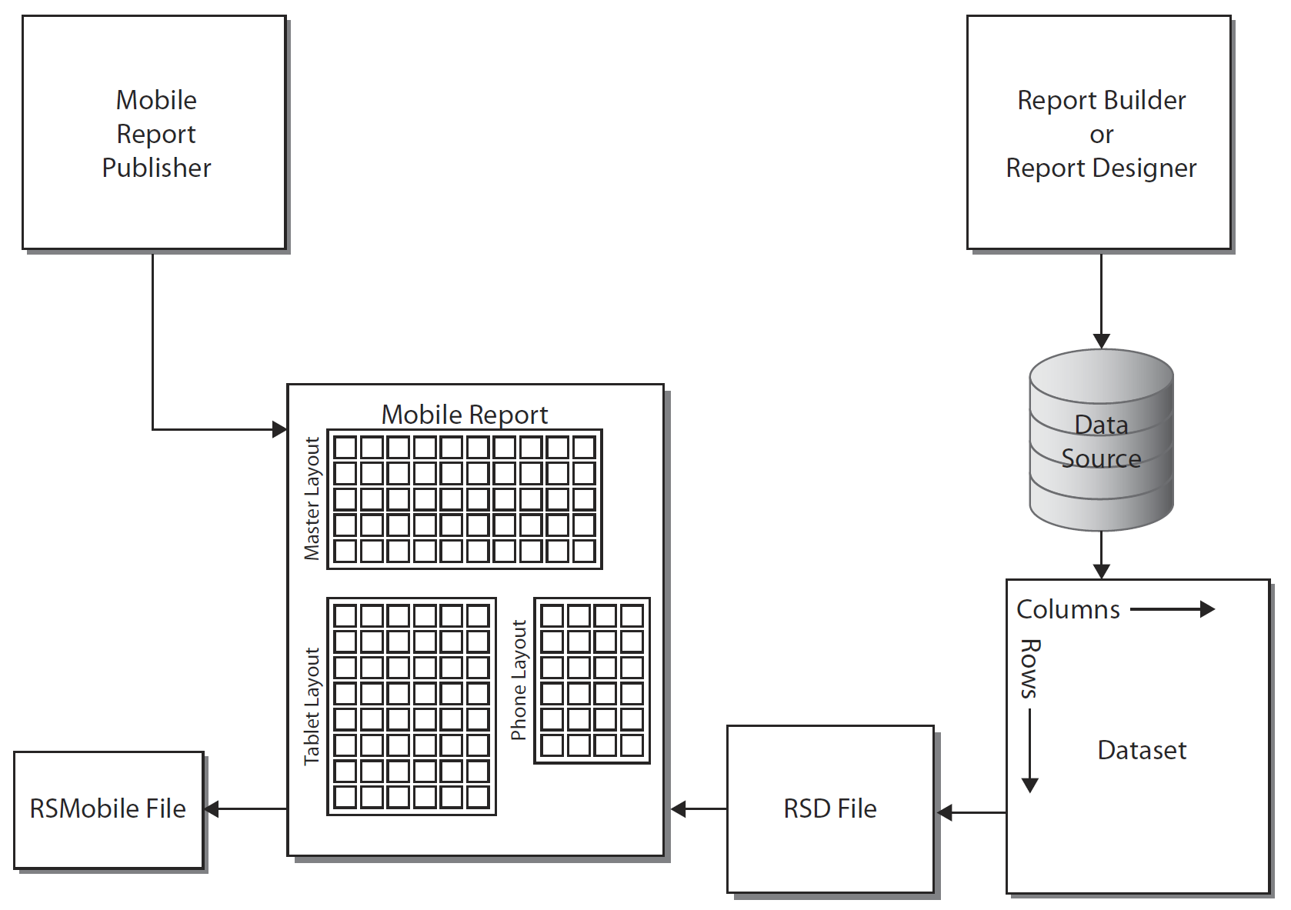
Mobile Report Structure
In a mobile report you will create a master layout, a tablet layout, and a phone layout.
The report will use whichever layout is most appropriate to the device displaying the report.

Slide 15
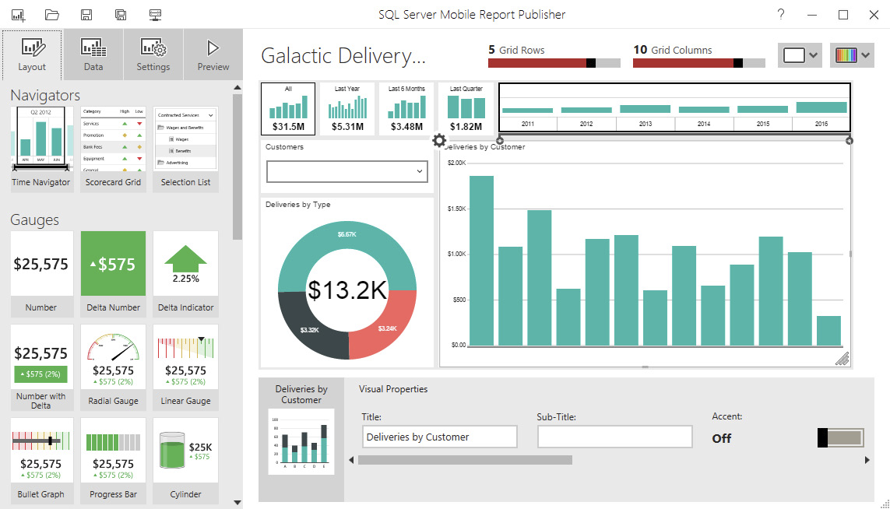
Mobile Report Publisher
This is the tool you use for creating and editing mobile reports.

Slide 16
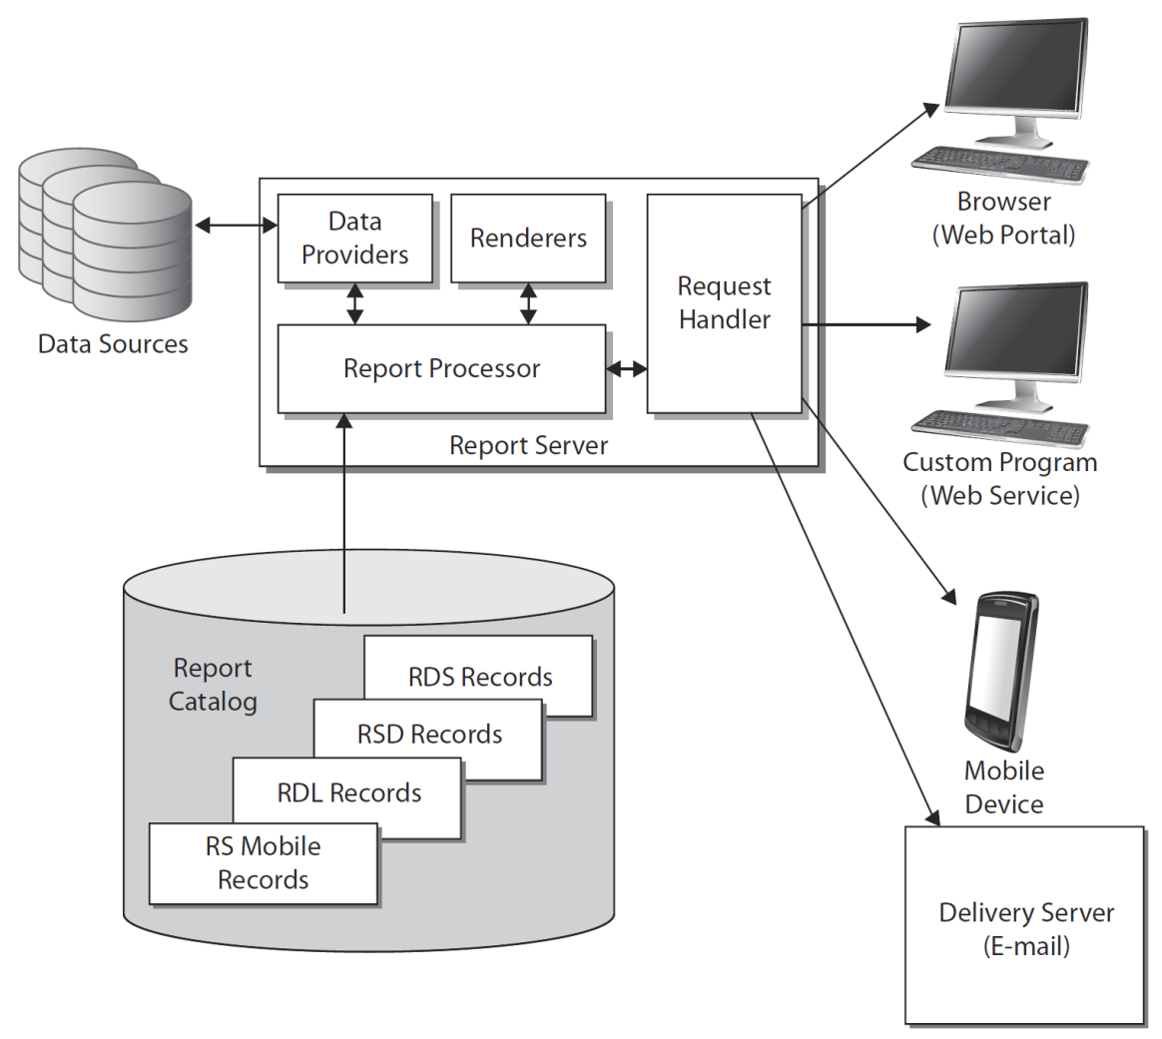
Report-Serving Architecture
The report server is the piece of the puzzle that makes Reporting Services the product it is. This is the software environment that enables you to share your reports with the masses—at least, those masses who have rights to your server.
When a report, shared data source, or shared dataset is deployed to a report server, a copy of the object’s definition is put in that server’s Report Catalog. The Report Catalog is a set of databases used to store the definitions for all of the reports and other objects available on a particular report server. It also stores the configuration, security, and caching information necessary for the operation of that report server.

Slide 17
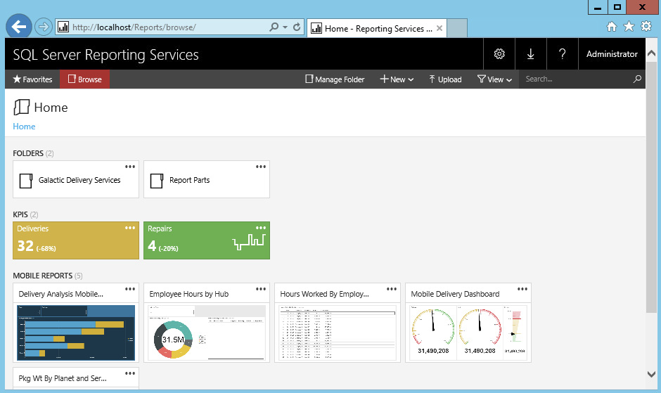
The Reporting Services Web Portal
One way for users to request a report from the report server is through the Reporting Services web portal.
This website is created for you when you install Reporting Services in native mode.

Slide 18


Slide 19

Install SQL Server Reporting Services
Refer to 06.1 Install SQL Server Reporting Services.pptx.

Slide 20
Create a Report Server Project Wizard
Refer to 06.2. Create a Report Server Project Wizard.pptx.

Slide 21
Create a Report Server Project
Refer to 06.3. Create a Report Server Project.pptx.

Slide 22
Create a Row Group
Refer to 06.4. Create a Row Group.pptx.

Slide 23
Create a Matrix Report
Refer to 06.5. Create a Matrix Report.pptx.

Slide 24
Create a Report with Parameter
Refer to 06.6. Create a Report with Parameter.pptx.

Slide 25
Create a Report with Stored Procedure
Refer to 06.7. Create a Report with Stored Procedure.pptx.

Slide 27
Create Cascading Parameters
Create independent stored procedure and dataset.
Create SSRS parameter (e.g. SpeciesCode) and set the parameter's available values with the independent dataset.
Create dependent stored procedure with parameter having the same name as the independent SSRS parameter name (e.g. @SpeciesCode) and dataset.
Create dependent SSRS parameter and set this parameter's available values with the dependent dataset.

Slide 28
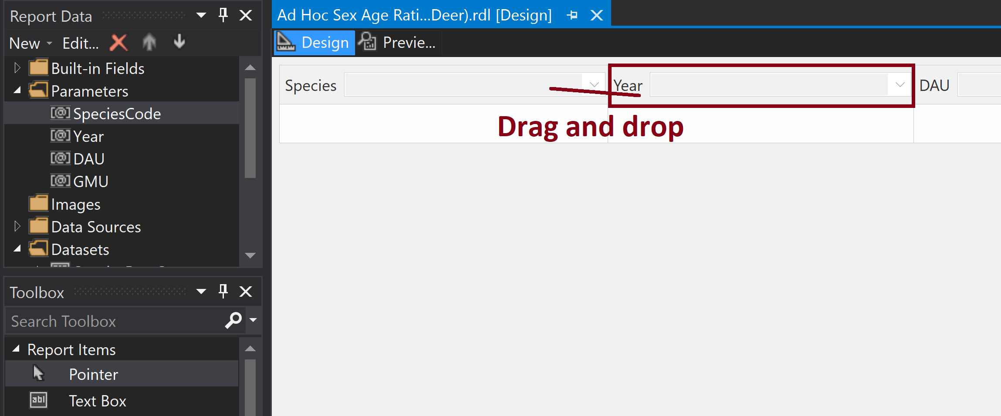
Change Parameter Position

Slide 29
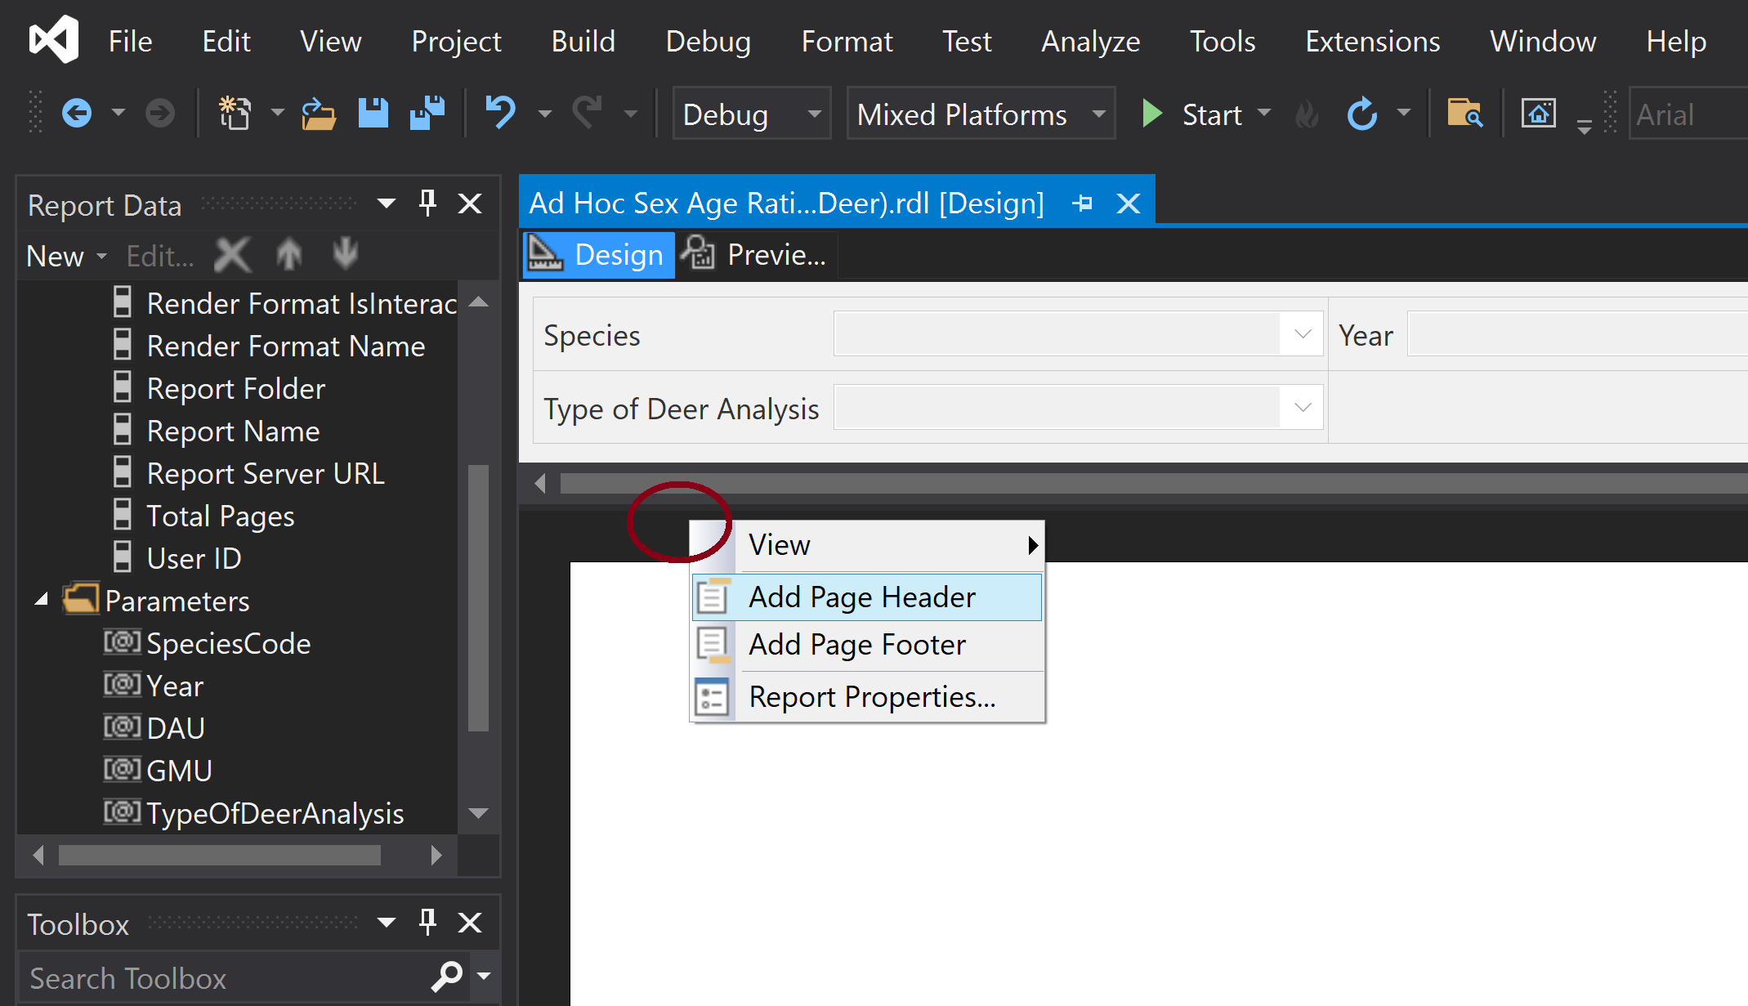
Insert Header and Footer

Slide 30
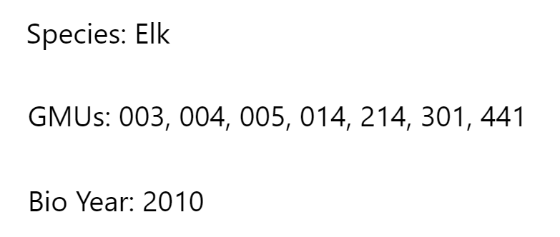
Show Parameter
= "Species:" & Parameters!SpeciesCode.Label
= "GMUs: " & Join(Parameters!GMU.Label, ", ")
= "Bio Year: " & Parameters!Year.Value

Slide 31

Further Reading
https://www.tutorialgateway.org/ssrs-report-parameters/
https://www.youtube.com/playlist?list=PL7A29088C98E92D5F

Slide 32

Thank You & See You Again

